Slide 1
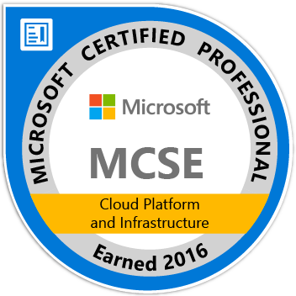
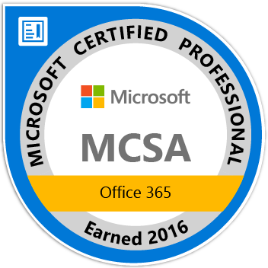
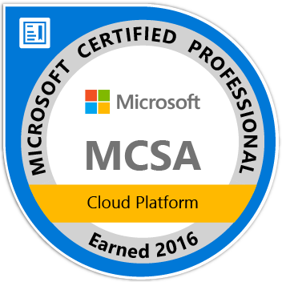

Feedback and Tips
http://blog.kloudezy.com
Niraj Kumar
Lead Azure Architect-E&Y, MCT(Microsoft Certified Trainer)
AzureTalk community group moderator
https://www.kloudezy.com

Slide 2
Agenda
Additional Resources
Azure Talk, A Chat based Azure community group
Success Stories
Copyright MICROSOFT Not for public disclosure

Slide 3
Additional Resources(Laser focused)
Microsoft OpenEdx: The best Azure learning portal from Microsoft for free!! Particularly the course Architecting Microsoft Azure Solutions
Free Measure UP Practice Test from MAPA( Microsoft Association or Practicing Architect)
Free Online Azure courses from Pluralsight, courtesy Microsoft.
Free Online Virtual Lab from Microsoft
1 yr of free services, $200 for 1st month
Extra training opportunity as part of free Visual Studio Essentials.
50$/100$/150$ monthly Azure Credit as part of MSDN/Visual Studio subscription
Copyright MICROSOFT Not for public disclosure

Slide 4
Azure Talk, Widening Azure Cloud Lenses
Azure Talk is an IM/Chat based Azure Community Group!
Platform for learning & asking questions on Azure
Sharing knowledge and real-world implementation experience
1200+ members strong Azure community and it’s growing even stronger.
Our Community heroes take big pride in helping the Community!
Azure Talk Online session
Absolutely free, 1-hour weekly recurring session to learn Azure!
More than 15 online sessions delivered till date
Please register at www.kloudezy.com
Copyright MICROSOFT Not for public disclosure

Slide 5
Success Stories
Let’s hear from those who successfully did it! ☺

Slide 6
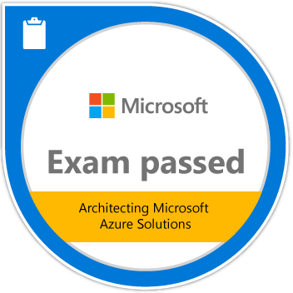

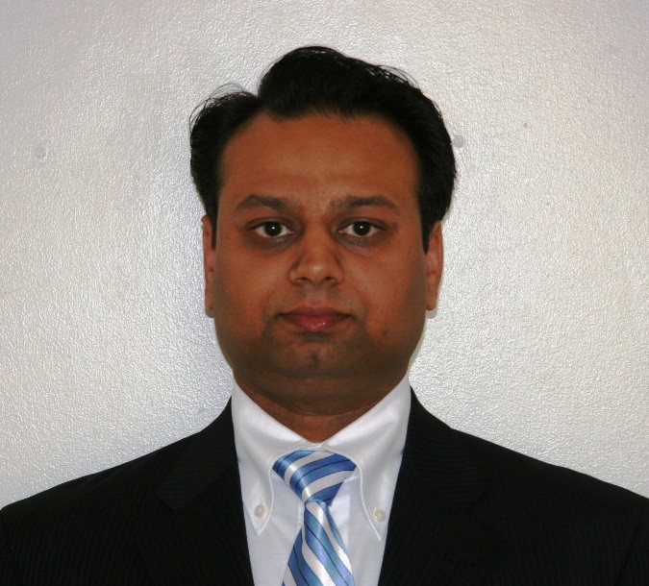
Azure Exam Preparation
Shobhit Kumar
Enterprise Architect – Lead :Cloud & Hosting Domain for EY MCP(Microsoft Certified Professional)
Shobhit Kumar, Enterprise Architect!

Slide 7
Success Story
How I benefitted from Jump-Start Sessions
The Session gave right launch pad to start
Modular Course Curriculum was very helpful
Documentation provided was very useful and informative
How I prepped for the exam
Go register and sign up for the Exam(Online Proctored or Exam center)
If you feel so purchase the practice exams (optional)
Revised with Jump start slide decks and Flash cards
Quick Links
Do NOT rely on the brain dump questions on the internet !!!
Shobhit Kumar, Enterprise Architect!

Slide 8
Tips & Tricks
Time availability for the exam – Just enough. Be patient and look for the “Trick questions” , the ones with – NOT , Does Not , All except , All of the above or even None of the above etc.…
Manage /Divide your time accordingly because you have around 65 questions in 150 minutes and a lot of case studies to read.
Minimum score is 700/1000 so fight for every question that you can answer correctly.
Read questions first and then read the case study (Saves time).
The case studies are complex and the section is enclosed – i.e. once you answer & leave the section you cannot go back. (Put 15-20 Minutes/Case Study. 5-6 questions per case study)
Create Notes/Flash cards and read the Azure Services limits, sizes and plans just before taking the exam.
Take your time and revisit your responses.
Have absolutely no clue about a question!! Use logic and try to eliminate some of the wrong answers.
Make sure to attempt all questions before moving to next section – Remember you cannot come back once you have submitted the section responses!!
There is a section with Yes /No question – you only get one attempt to it. Respond before you move on , even within the section.
Everyone is different – Identify your strong areas and target it as much as you can.
Lastly – LAB !! LAB !! LAB !! - “Login and get hands on” - Really helps a lot
Good Luck !!
Shobhit Kumar, Enterprise Architect!

Slide 9
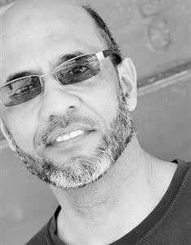

Azure Talk – Azure Service Fabric
Muhammad Hashmi
Solution Architect
Muhammad Hashmi, Cloud Architect!

Slide 10
Topic
What I learnt from Jump-Start Session
Confidence; I launched my exam preparation right after attending Jump-Start session
Where are the resources, and information about how to prepare for the test
Hand-on experience is critical.
How I did it!
Subscribed to MeasureUp Practice Tests
Practice through Virtua Labs
Microsoft Virtual Academy (https://mva.microsoft.com/)
Tips and Tricks!
During the test remove obvious incorrect answers before choosing between two or more possible answers. Sometimes you can narrow down to the only correct answer
Understand basic PowerShell code; variables and commands
Attempt 70-534 first followed by 70-533
Read all questions first before reading the Case Study document. You will know what to capture from the case study.
One number or word will make a difference and alter the answer

